Slide 1
[220 / 319] Files

Slide 2
Learning Objectives Today
Basic file interactions
opening/closing
reading/writing
OS module
listdir, mkdir, exists, isdir, isfile, join
File exceptions
Encodings

Slide 3
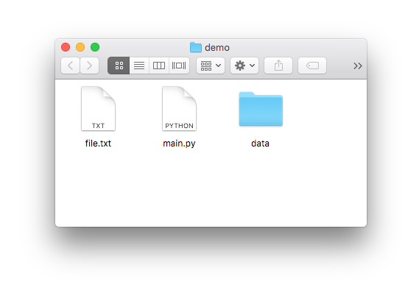
File objects
built-in open function
main.ipynb:
f = open(path) # read data from f # OR # write data to f f.close()
file object
file path
we’re running the code here

Slide 4
File objects
built-in open function
main.ipynb:
f = open(“file.txt”) # read data from f # OR # write data to f f.close()
file object
file path
suppose we want to open file.txt

Slide 5
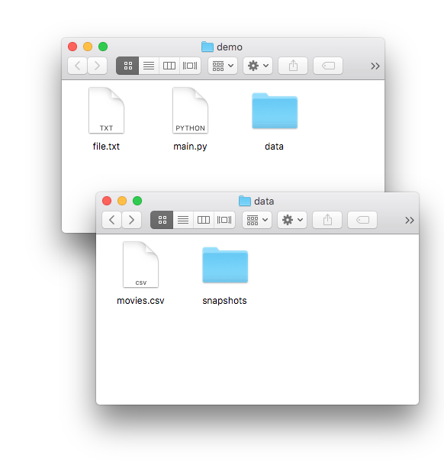
File objects
built-in open function
main.ipynb:
f = open( “data/movies.csv”) # read data from f # OR # write data to f f.close()
file object
file path
data/movies.csv

Slide 6
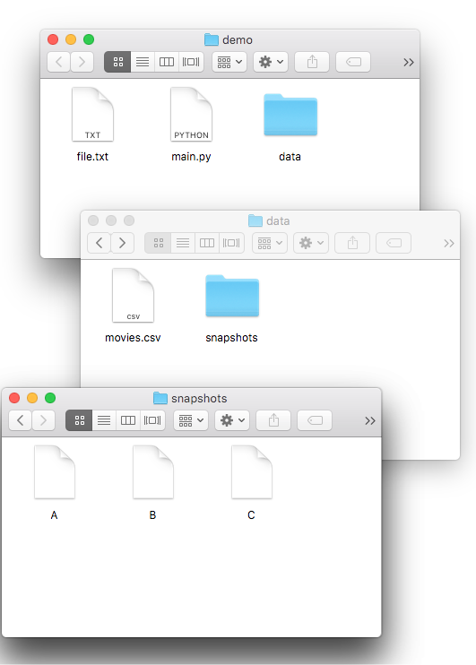
File objects
built-in open function
main.ipynb:
main.ipynb:
f = open( “data/snapshots/A”) # read data from f # OR # write data to f f.close()
file object
file path
data/snapshots/A

Slide 7

File objects
imagine a file object as a sandwich…
f = open(…)
main.ipynb:
use file
main.ipynb:
f = open(“file.txt”) # read data from f # OR # write data to f f.close()
f.close()
using file
Reasons for closing
avoid data loss
limited number of open files
cleanup

Slide 8
Learning Objectives Today
Basic file interactions
opening/closing
reading/writing
OS module
listdir, mkdir, exists, isdir, isfile, join
File exceptions
Encodings

Slide 9
Reading a file
f = open(“file.txt”) # read data from f # OR # write data to f f.close()
I promise to always close my files

Slide 10
Reading a file
f = open(“file.txt”) data = f.read()
print(data) f.close()
I promise to always close my files
Option 1
data is: “I promise\nto always\nclose my files”
read() method
fetch entire file contents
return as a string

Slide 11
Reading a file
f = open(“file.txt”) # read data from f # OR # write data to f f.close()
Option 2
file objects can be iterated over, using a for loop!

Slide 12
Reading a file – alternate ways
f = open("file.txt")
lines = list(f)
f.close()
convert it to a list
f = open("file.txt")
for l in f:
print(l)
f.close()
iterate over f with a for loop

Slide 13
Write a file
“w” mode indicates we want to write to this file
f = open(“file.txt”, “w”) # read data from f # OR # write data to f f.close()
I promise to always close my files

Slide 14
Write a file
“w” mode indicates we want to write to this file
f = open(“file.txt”, “w”) f.write(“hello”) f.write(“ world\n”) f.write(“!!!!!\n”) f.close()
I promise to always close my files
let’s run it!

Slide 15
Write a file
“w” mode indicates we want to write to this file
f = open(“file.txt”, “w”) f.write(“hello”) f.write(“ world\n”) f.write(“!!!!!\n”) f.close()
opening with “w” is
dangerous. It immediately
wipes out your file.
(or creates a new one if there isn’t already a file.txt)

Slide 16
Write a file
“w” mode indicates we want to write to this file
f = open(“file.txt”, “w”) f.write(“hello”) f.write(“ world\n”) f.write(“!!!!!\n”) f.close()
hello world
!!!!!!
be careful with newlines
(write doesn't add them like print does)

Slide 17
Learning Objectives Today
Basic file interactions
opening/closing
reading/writing
OS module
listdir, mkdir, exists, isdir, isfile, join
File exceptions
Encodings

Slide 18
OS Module (Operating System)
Many functions in os and os.path for working w/ files
os.listdir
os.mkdir
os.path.exists
os.path.isfile
os.path.isdir
os.path.join

Slide 19
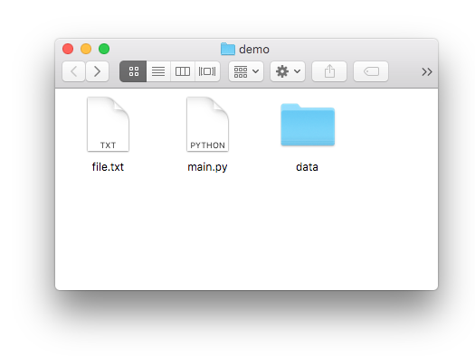
OS Module (Operating System)
Many functions in os and os.path for working w/ files
os.listdir
os.mkdir
os.path.exists
os.path.isfile
os.path.isdir
os.path.join
>>> import os
>>> os.listdir(“.”) [“file.txt”, “main.ipynb”, “data”]

Slide 20
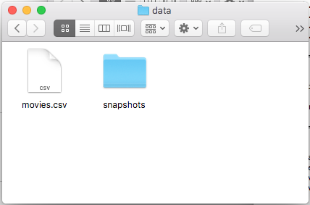
OS Module (Operating System)
Many functions in os and os.path for working w/ files
os.listdir
os.mkdir
os.path.exists
os.path.isfile
os.path.isdir
os.path.join
>>> import os
>>> os.listdir(“data”) [“movies.csv”, “snapshots”]

Slide 21
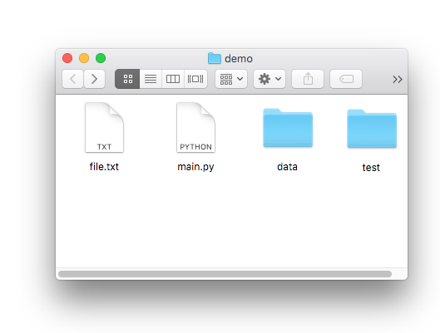
OS Module (Operating System)
Many functions in os and os.path for working w/ files
os.listdir
os.mkdir
os.path.exists
os.path.isfile
os.path.isdir
os.path.join
>>> import os
>>> os.mkdir(“test”)

Slide 22
OS Module (Operating System)
Many functions in os and os.path for working w/ files
os.listdir
os.mkdir
os.path.exists
os.path.isfile
os.path.isdir
os.path.join
>>> import os
>>> os.path.exists(“file.txt”) True
>>> os.path.exists(“haha.txt”) False

Slide 23
OS Module (Operating System)
Many functions in os and os.path for working w/ files
os.listdir
os.mkdir
os.path.exists
os.path.isfile
os.path.isdir
os.path.join
>>> import os
>>> os.path.isfile(“haha.txt”) False
>>> os.path.isfile(“file.txt”) True
>>> os.path.isfile(“data”) False

Slide 24
OS Module (Operating System)
Many functions in os and os.path for working w/ files
os.listdir
os.mkdir
os.path.exists
os.path.isfile
os.path.isdir
os.path.join
>>> import os
>>> os.path.isdir(“data”) True

Slide 25
OS Module (Operating System)
Many functions in os and os.path for working w/ files
os.listdir
os.mkdir
os.path.exists
os.path.isfile
os.path.isdir
os.path.join
>>> import os
>>> os.path.join(“data”, “movies.csv”) data/movies.csv
on Mac/Linux

Slide 26
OS Module (Operating System)
Many functions in os and os.path for working w/ files
os.listdir
os.mkdir
os.path.exists
os.path.isfile
os.path.isdir
os.path.join
>>> import os
>>> os.path.join(“data”, “movies.csv”) data\movies.csv
on Windows

Slide 27
Windows
Linux
Your project:
path = "\".join("data", "movies.csv")
f = open(path)
...
...
submit
you run test.py
we run test.py

Slide 28
Learning Objectives Today
Basic file interactions
opening/closing
reading/writing
OS module
listdir, mkdir, exists, isdir, isfile, join
File exceptions
Encodings

Slide 29
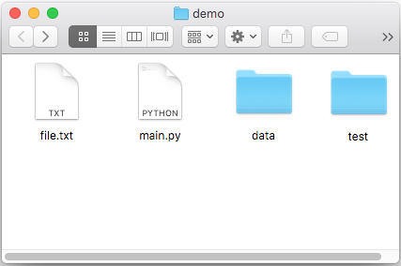
Exceptions
Working with files leads to many exceptions
missing files
lacking permissions
not enough space
mixing up directories and files
corrupt formats
etc, etc
import os
os.mkdir('dump')
f = open(os.path.join('dump', 'out.txt'), 'w')
f.write('hi')
f.close()

Slide 30
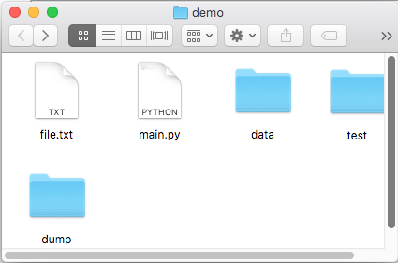
Exceptions
Working with files leads to many exceptions
missing files
lacking permissions
not enough space
mixing up directories and files
corrupt formats
etc, etc
run once
import os
os.mkdir('dump')
f = open(os.path.join('dump', 'out.txt'), 'w')
f.write('hi')
f.close()

Slide 31
Exceptions
Working with files leads to many exceptions
missing files
lacking permissions
not enough space
mixing up directories and files
corrupt formats
etc, etc
run again: CRASH!
import os
os.mkdir('dump')
f = open(os.path.join('dump', 'out.txt'), 'w')
f.write('hi')
f.close()
Traceback (most recent call last):
File "test2.py", line 3, in <module>
os.mkdir('dump')
FileExistsError: [Errno 17] File exists: 'dump'

Slide 32
Exceptions
Working with files leads to many exceptions
missing files
lacking permissions
not enough space
mixing up directories and files
corrupt formats
etc, etc
run again with try/except
import os
try:
os.mkdir('dump')
except FileExistsError:
pass # ignore it if dump already existed
f = open(os.path.join('dump', 'out.txt'), 'w')
f.write('hi')
f.close()

Slide 33
Learning Objectives Today
Basic file interactions
opening/closing
reading/writing
OS module
listdir, mkdir, exists, isdir, isfile, join
File exceptions
Encodings

Slide 34
Exercise: person 1 encodes a word with encoding 1,
person 2 decodes with encoding 2
Word:
ukulele
A 00001
B 00010
C 00011
D 00100
E 00000
F 00110
G 00111
H 01000
I 01001
J 01010
K 01011
L 11111
M 01101
N 01110
O 01111
P 10000
Q 10001
R 10010
S 10011
T 10100
U 10101
V 10110
W 10111
X 11000
Y 11001
Z 11010
A 00001
B 00010
C 00011
D 00100
E 00000
F 00110
G 00111
H 01000
I 01001
J 01010
K 01111
L 10101
M 01101
N 01110
O 01011
P 10000
Q 10001
R 10010
S 10011
T 10100
U 01100
V 10110
W 10111
X 11000
Y 11001
Z 11010
encoding 1
encoding 2

Slide 35
Exercise: person 1 encodes a word with encoding 1,
person 2 decodes with encoding 2
Word:
ukulele
lol?e?e
A 00001
B 00010
C 00011
D 00100
E 00000
F 00110
G 00111
H 01000
I 01001
J 01010
K 01011
L 11111
M 01101
N 01110
O 01111
P 10000
Q 10001
R 10010
S 10011
T 10100
U 10101
V 10110
W 10111
X 11000
Y 11001
Z 11010
A 00001
B 00010
C 00011
D 00100
E 00000
F 00110
G 00111
H 01000
I 01001
J 01010
K 01111
L 10101
M 01101
N 01110
O 01011
P 10000
Q 10001
R 10010
S 10011
T 10100
U 01100
V 10110
W 10111
X 11000
Y 11001
Z 11010
encoding 1
encoding 2

Slide 36
Encoding Defaults Done Wrong
Mac
Windows
f = open('example.txt', 'w', encoding='utf-8')
f.write('baño')
f.close()
f = open('example.txt', ‘r',
encoding='cp1252')
print(f.read())
f.close()
example.txt
example.txt
Windows computer prints “baÃ±o” instead of “baño”

Slide 37
Encoding Defaults Done Wrong
Mac
Windows
f = open('example.txt', 'w', encoding='utf-8')
f.write('baño')
f.close()
f = open('example.txt', ‘r',
encoding='cp1252')
print(f.read())
f.close()
example.txt
example.txt
Takeaway: if you see weird characters printed by
your program, it’s a good time to learn more about encodings

Slide 38
Coding Demos

Slide 39
Demo 1: add numbers in a file
Goal: read all lines from a file as integers and add them
Input:
file containing 50 million numbers between 0 and 100
Output:
The sum of the numbers
Example: Sum of numbers: 2499463617
Two ways:
Put all lines in a list first
Directly use iterable file
Bonus: create generator function
that does the str => int conversion

Slide 40
Challenge - Demo 1: Score Tracker
Goal: tally up points, and print who is winning
Input:
Person who just scored
Output:
Everybody’s score
Example: ”Enter winner’s name”: alice alice: 1
”Enter winner’s name”: bob alice: 1 bob: 1
”Enter winner’s name”: alice alice: 2 bob: 1

Slide 41
Challenge - Demo 2: File Finder
Goal: search directories (recursively) for a given file name, then print that file
Input:
The filename to search for
Output:
The contents of that file

Slide 42
Challenge - Demo 3: sorting files by line length
Goal: output file contents, with shortest line first
Input:
a text file
Output:
print lines sorted

